Slide 1
Computational Thinking & Systems Design (CSTD) Lecture 15 Revisit ideas we learned CSTD in Autumn 2020: The Why/How/Whats of CSTD?
Ben Koo
December 22, 2020

Slide 2
Context: Describe the Spatial and Temporal boundaries of the project.
Abstract Specification
Goal: Mission Statement written in an imperative sentence with reference to “Context”.
Measurable Effects: Conditional statements of the observable implementation outcomes that satisfy the “Goal”.
Concrete Implementation Process
Outputs
A list of noun phrases that declares the deliverable items from proposed activities
Activities
A structured set of actions that depicts implementation activities.
Ideally written in a formalized process specification language
Inputs
Prescribe the required resources to be consumed in the implementation Process
Boundary Conditions: When and how the boundaries of the previously defined ”Context” could be broken?

Slide 3

Logic Model
Logic Model
Output: A set of learning result documents, in both source code form and textual descriptions (Wiki)
Process: Lectures, Exercises and Code Reviews
Input:
The prior work on http://nand2Tetris.org
Reference materials (online and prints)
Mathematical insights and philosophical groundings
Historical linkages and industry case studies
Context: In the second half of year 2020, engage students to experience CTSD in 3 lecture hour x 15 week time frame, remotely.
Goal: Demonstrate that CTSD is universally applicable to a wide range of systems and life experiences
Criteria:
Build a full stack computing system
Make connections to grounding theories
Offer tools and methods to enable CTSD.
A well-defined set of Actions and iterative Branching Strategies
A Roadmap of composable activities
Sequencing and timing conditions
Explicitly state dependencies and resource requirements
Boundary Conditions: Students who are willing to learn and capable of debugging code

Slide 4
A curriculum based on Data-assimilation Orientation

Slide 5
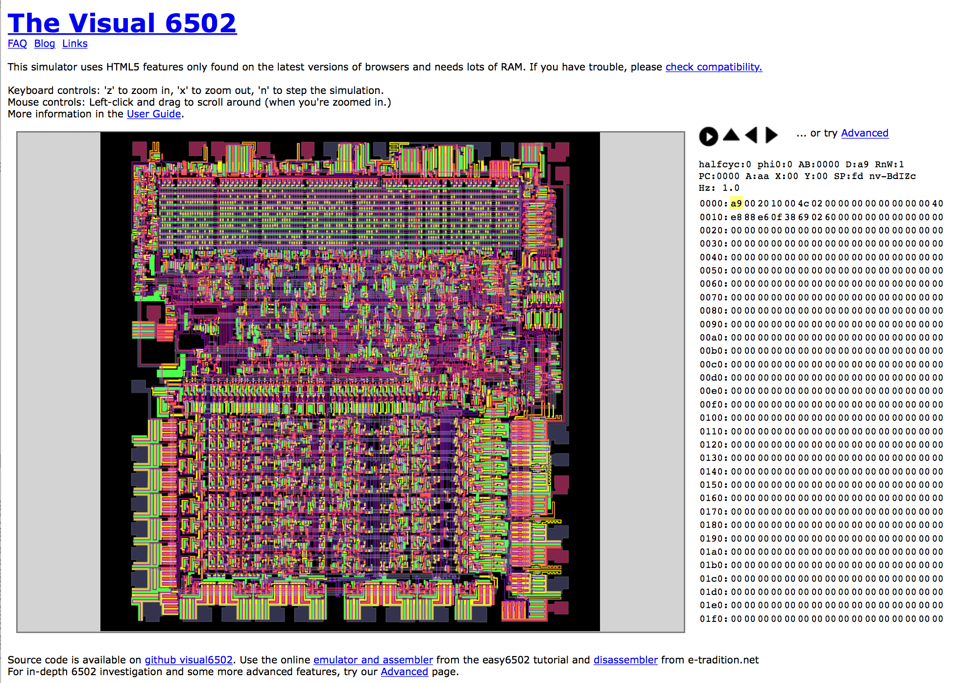
CPU is “Universal” (万用)
https://en.wikipedia.org/wiki/MOS_Technology_6502
http://www.visual6502.org/JSSim/index.html

Slide 6
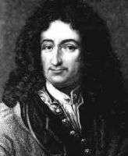
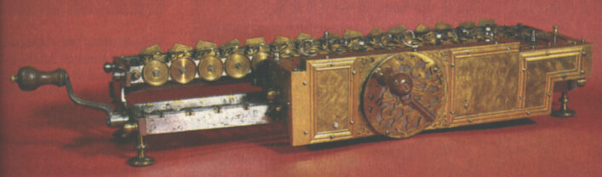
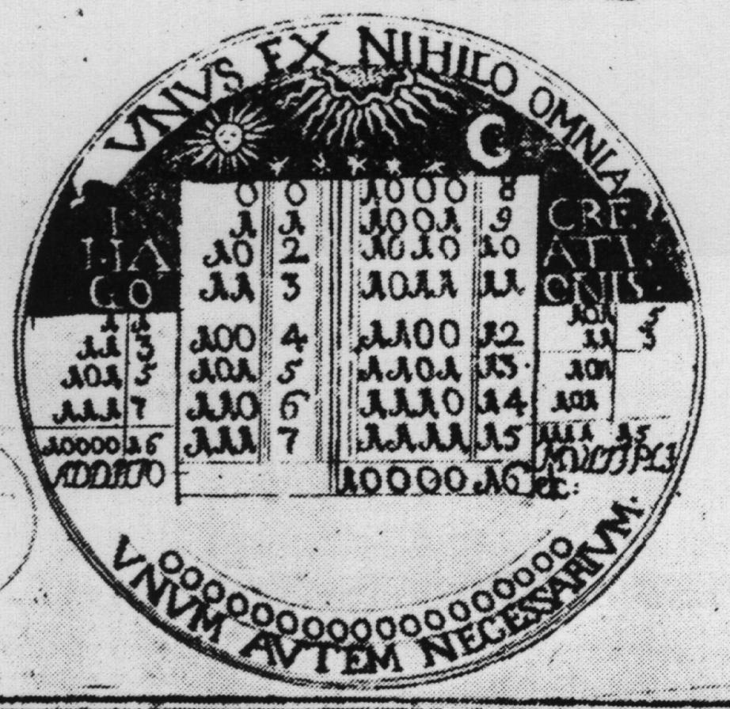
Historical end-note: Leibnitz (1646-1716)
“The binary system may be used in place of the decimal system; express all numbers by unity and by nothing”
1679: built a mechanical calculator (+, -, *, /)
CHALLENGE: “All who are occupied with the reading or writing of scientific literature have assuredly very often felt the want of a common scientific language, and regretted the great loss of time and trouble caused by the multiplicity of languages employed in scientific literature:
SOLUTION: “Characteristica Universalis”: a universal, formal, and decidable language of reasoning
The dream’s end: Turing and Gödel in 1930’s.
Leibniz’s medallion for the Duke of Brunswick

Slide 7
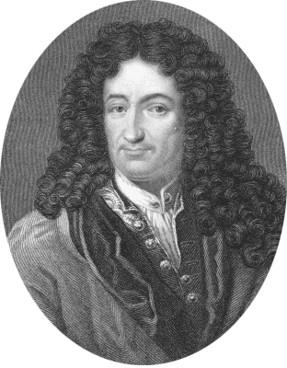
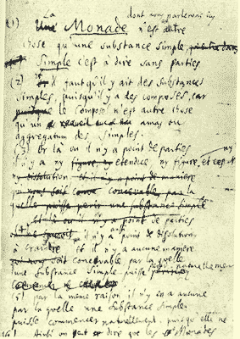
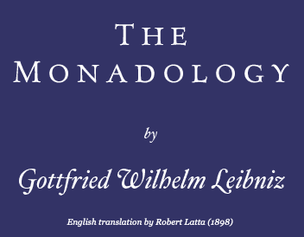
Monad and Leibniz
The Monad, of which we shall here speak, is nothing but a simple substance, which enters into compounds. By ‘simple’ is meant ‘without parts’. (Theod. 10.)
And there must be simple substances, since there are compounds; for a compound is nothing but a collection or aggregatum of simple things.
Now where there are no parts, there can be neither extension nor form [figure] nor divisibility. These Monads are the real atoms of nature and, in a word, the elements of things.
…. From home.datacomm.ch/kerguelen/monadology/monadology.html

Slide 8
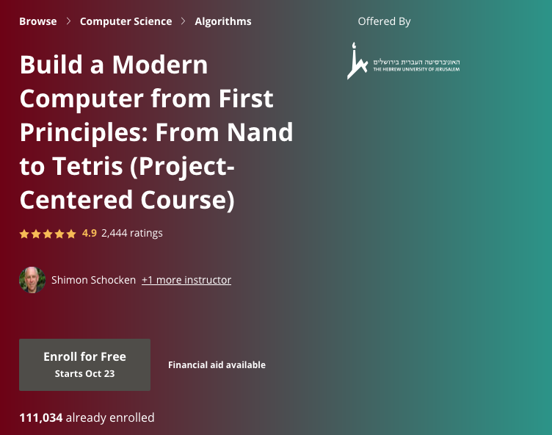
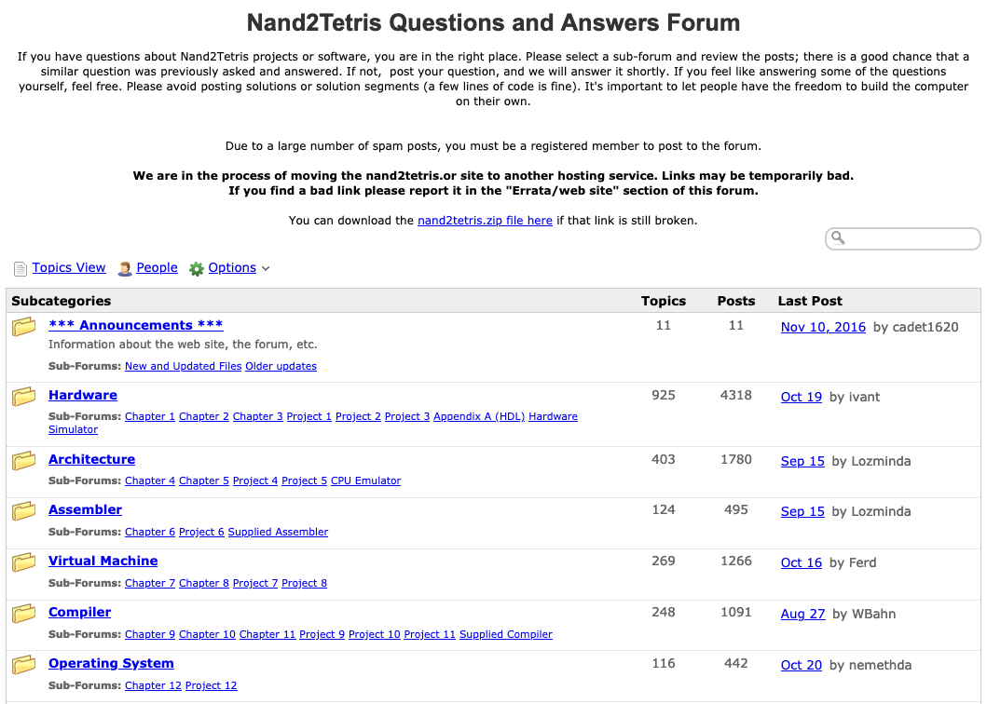
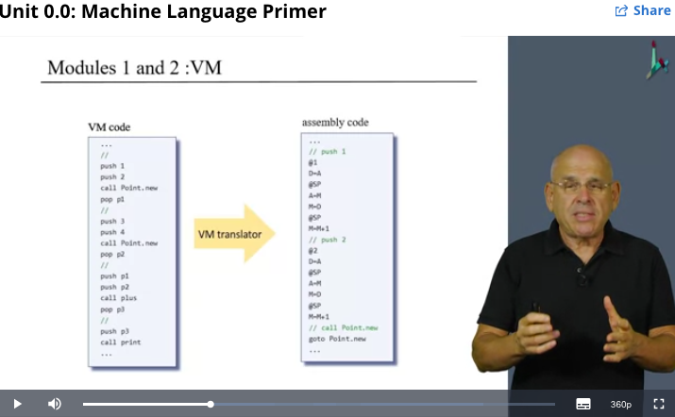
Homework assistance and Self-Study Guidance
http://tecs-questions-and-answers-forum.32033.n3.nabble.com/

Slide 9
Overview of the Nand2Tetris System
Hardware
Software
hierarchy
hierarchy
Human Machine Interfaces
Human
Physics
Operating System
Thought
Electrical Engineering
Layer 7
Compiler
Layer 1
Chips and Logic Gates
Systems Design
High Level Language
Chapter 13-15
Chapter 1-3
Layer 2
Layer 6
Chapter 10-11
Hardware Platform
VM Translator
User Defined Applications
Knowledge Representation
Logics and Arithmetic
Layer 3
Layer 5
Machine Language
Virtual Machine
Chapter 4-5
Chapter 9-12
Layer 4
Product/Service Design
Computer Architecture
Assembly Language
Chapter 6
Chapter 7-8

Slide 10
We live in a Smart World,
Driven by Physically Meaningful Data
Image credits: http://verses.io

Slide 11
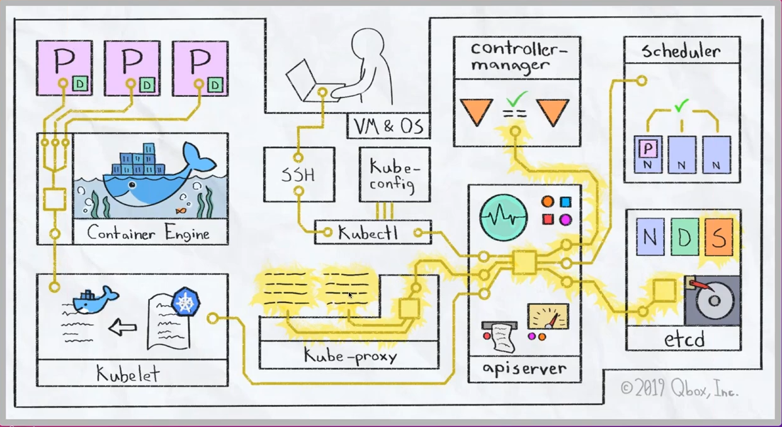
Operationalizing Computation through Cybernetics
How to deploy a Kubernetes Cluster from Scratch (Youtube Link)

Slide 12
Universal (Logical) Components
There are total of 16 possible 2 input 1 output Logical Functions.
Other than XOR, XNOR, A, B, ~A, ~B, 0, and 1, all remaining ones are
Universal Logical Gates…
A | B | Not(A and B) | Not(A or B) | A and Not(B) | B and Not(A) | A or Not(B) | Not(A) or B
0 | 0 | 1 | 1 | 0 | 0 | 1 | 1
0 | 1 | 1 | 0 | 0 | 1 | 0 | 1
1 | 0 | 1 | 0 | 1 | 0 | 1 | 0
1 | 1 | 0 | 0 | 0 | 0 | 1 | 1
These four gates are representable by Gibb’s Free Energy

Slide 13
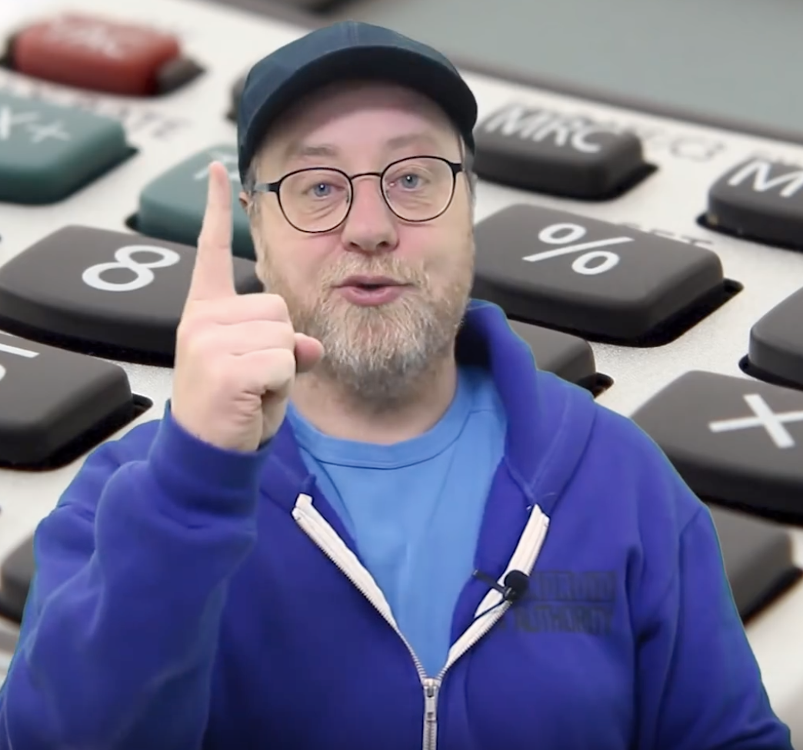
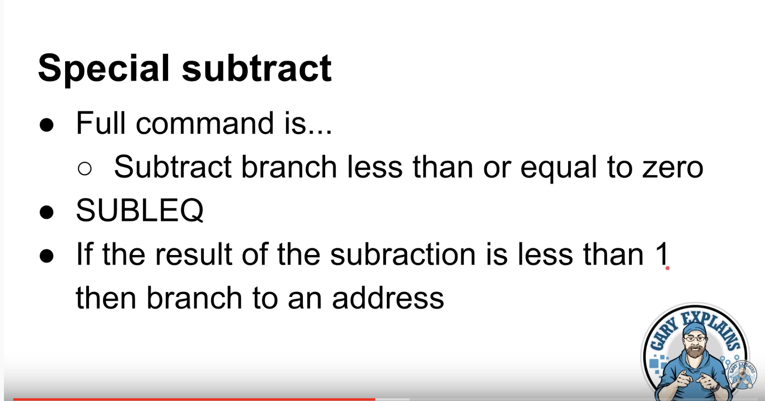
A CPU With Just One Instruction!!!
Gary Explains: https://youtu.be/jRZDnetjGuo

Slide 14
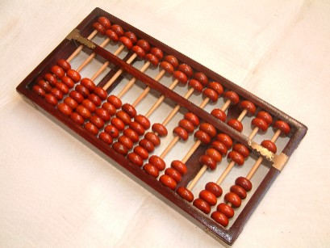
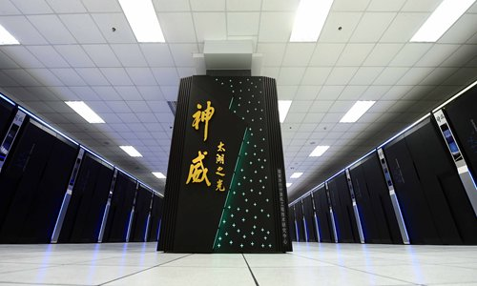
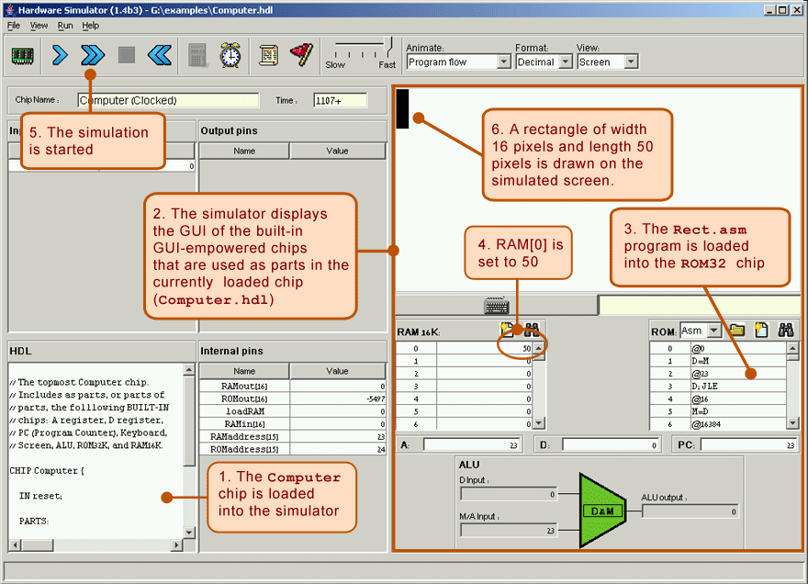
Proposed Computational Thinking
A Namespace of Functions for the available Computing Devices
that fit their respective application contexts.

Slide 15
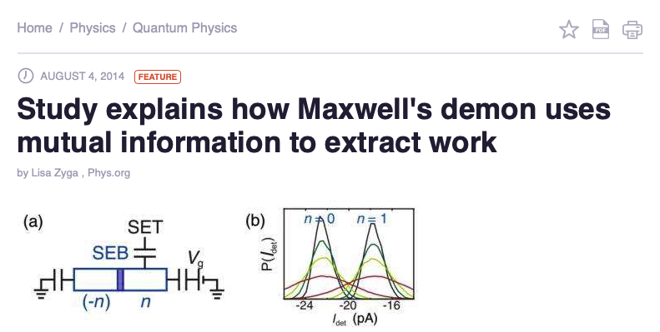
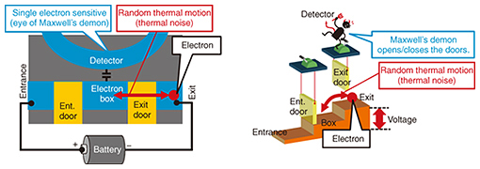
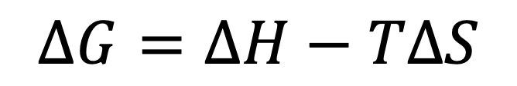
Transistors as Maxwell’s Demons
A mechanism to control electrons (moving particles) to
get through a gate or not.
Governed by Gibb’s Free Energy equation:
$$ΔG=ΔH−TΔS$$

Slide 16
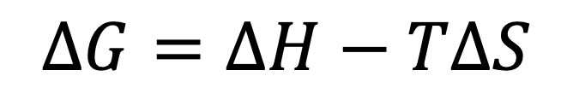
Gibb’s Free Energy states:
$$ΔG=ΔH−TΔS$$
Sign of ΔG | Sign of ΔH | Sign of ΔS | Process Type
Negative | Negative | Positive | Spontaneous
Either way | Negative | Negative | Spontaneous when Cold
Either way | Positive | Positive | Spontaneous when Hot
Positive | Positive | Negative | Non-Spontaneous
Spontaenous =
Deterministic, guaranteed.
Sign of ΔH | Sign of ΔS | Sign of ΔG | Universal Gates
0 | 0 | ? | A or Not B=1, A and Not B=0
0 | 1 | 0 | A or Not B=0, A and Not B=0
1 | 0 | 1 | A or Not B=1, A and Not B=1
1 | 1 | ? | A or Not B=1, A and Not B=0
Turning +/- into 1/0,
we get a Truth Table,
Where
the first two columns are
Inputs,
the third is the output

Slide 17
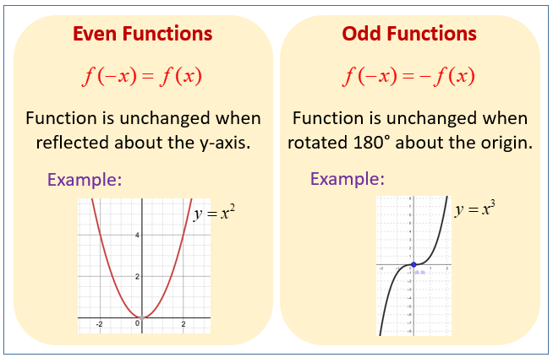
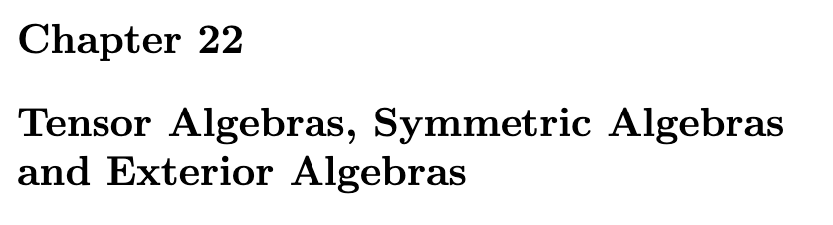
Think of Universal Logic Gates as
A | B | Not(A and B) | Not(A or B) | A and Not(B) | B and Not(A) | A or Not(B) | Not(A) or B
0 | 0 | 1 | 1 | 0 | 0 | 1 | 1
0 | 1 | 1 | 0 | 0 | 1 | 0 | 1
1 | 0 | 1 | 0 | 1 | 0 | 1 | 0
1 | 1 | 0 | 0 | 0 | 0 | 1 | 1
Anti-Symmetric Functions.
Non-even, or Odd Functions
Prof. Dasgupta:
A core idea in Tensor Algebra:
Co-Variant and Contra-Variant
Course note of Prof. Jean Gallier
OnlineMathLearning.com

Slide 18
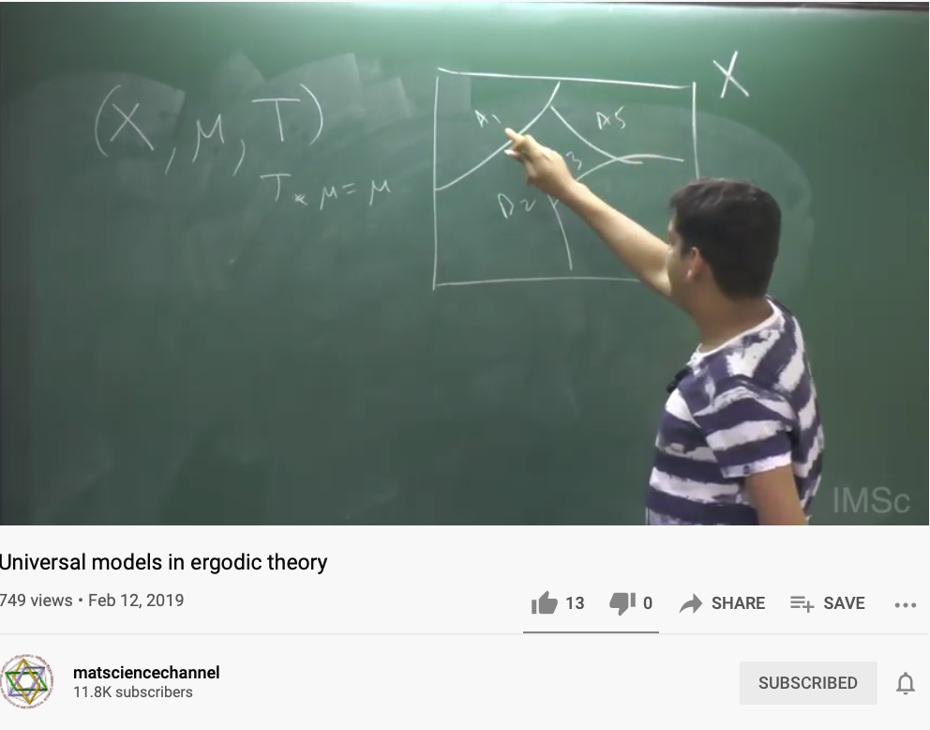
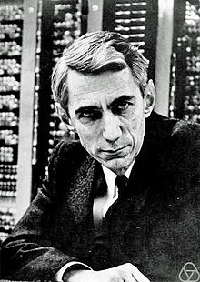
Universal Models in Ergodic Theory
Claude Elwood Shannon: known as "the father of information theory".^{[1][2]} Shannon is noted for having founded information theory with a landmark paper, "A Mathematical Theory of Communication", which he published in 1948.
He is also well known for founding digital circuit design theory in 1937, when—as a 21-year-old master's degree student at the Massachusetts Institute of Technology (MIT)—he wrote his thesis demonstrating that electrical applications of Boolean algebra could construct any logical numerical relationship.^{[3]} Shannon contributed to the field of cryptanalysis for national defense during World War II, including his fundamental work on codebreaking and secure telecommunications.
Claude Shannon linked:
Applied Boolean Algebra to Circuit Design
A way to name the possibility space,
While measuring the probability of content transmission using Ergodic assumptions.
matsciencechannel

Slide 19
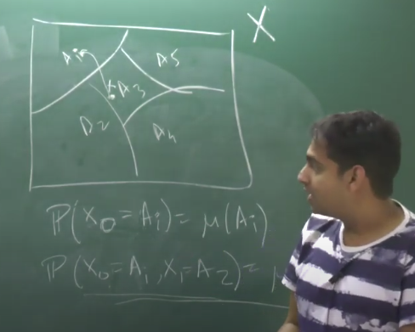
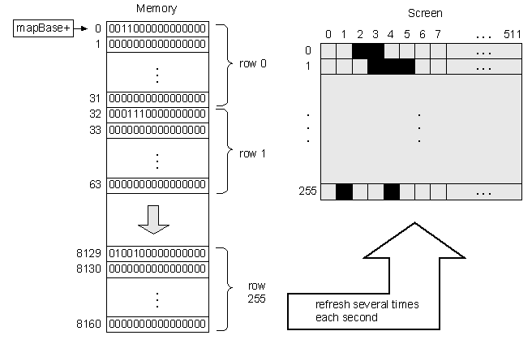

Think about Memory Mapped Screen
matsciencechannel

Slide 20

Abstraction
Separate Specification from Abstraction
Concretization
Why is abstraction useful?
Allow reuse through universal properties
Avoid resource conflicts
Scale free and domain neutral
Generalizing concrete experience?
Make analogies in localized contexts
Engage sensible metaphors
Define terms and boundaries
A well-defined set of Actions and iterative Branching Strategies
A Roadmap of composable activities
Sequencing and timing conditions
Explicitly state dependencies and resource requirements

Slide 21


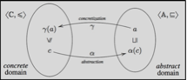
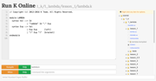

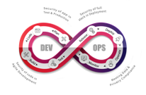
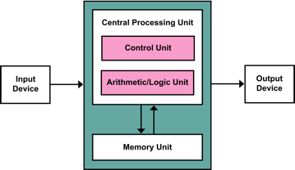
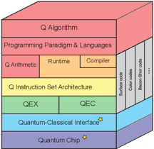






Computing Architectures associated with Tools
Abstract Specification
Cloud Computing
Deterministic
Probabilistic
Centralized
Hybrid
Distributed
Single/Multi Core
Many Core
Single Site
Multi Site
Many Site
Hackerspaces
Super Computing Center
Notes:
21

Slide 22
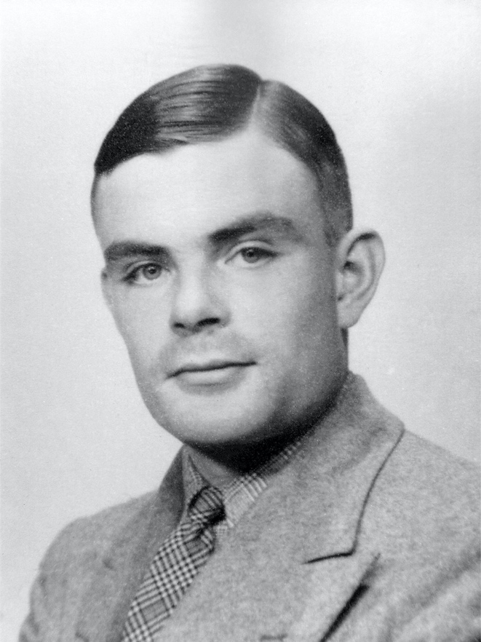
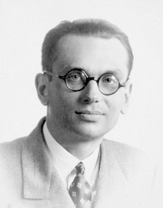
Universality and Turing Completeness
Turing complete means a machine can carry out all possible computations.
An operationalized
Model of
Universal Computation
Incompleteness
Theorem
Image source: Britannica.com Alan Turing
Image source: Wikipedia Kurt Godel

Slide 23

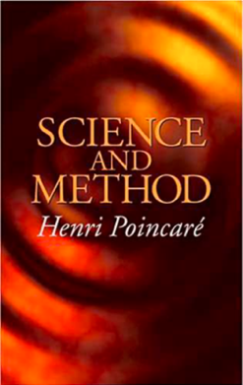
Data Science = Namespace Management
A natural equivalence that is
up-to-isomorphism to relevant domains.
A method that matches your application context,
without the losing scope of possible alternatives.

Slide 24
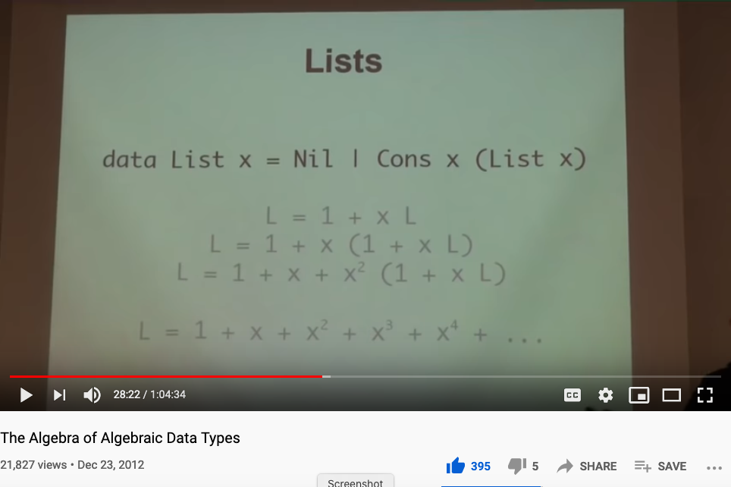
A insightful lecture on the Algebra of Namespaces?
The Algebra of Algebraic Data Types

Slide 25
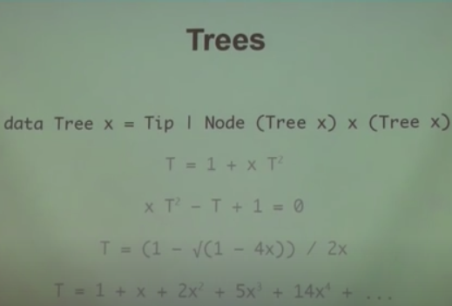
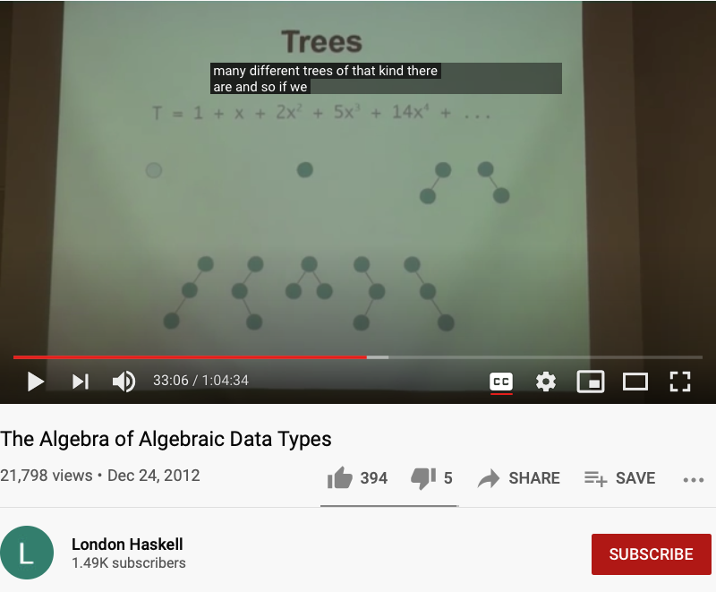
The Algebraic features of Data Types
Huawei VP Mr. Yang Shaoqing
https://youtu.be/YScIPA8RbVE?t=2040
https://youtu.be/YScIPA8RbVE?t=1986

Slide 26
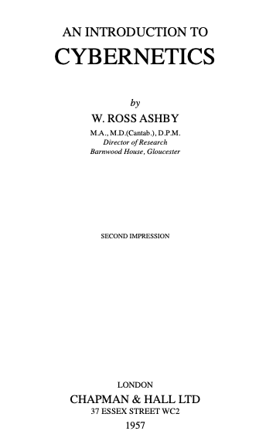
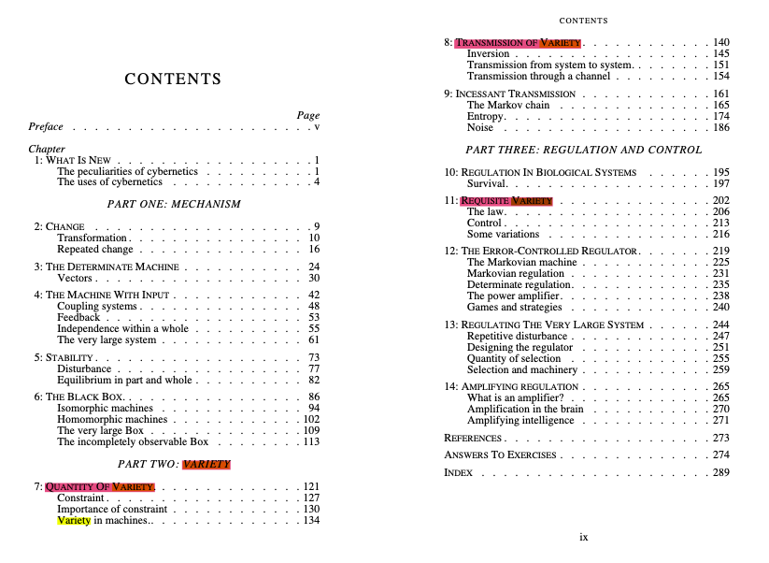
Namespace Management and Cybernetics
NsM = Quantity/Transmission and Requisite Variety
Huawei VP Mr. Yang Shaoqing

Slide 27
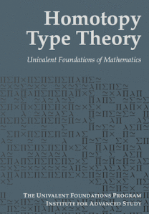
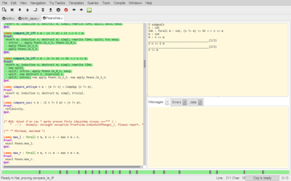

Universal Constructs
The most general possible way to name things consistently!
Coq:
Interactive Proof Assistant
Based on Univalence Foundations and the Coq Proof assistant, Voevodsky created a path to organize mathematical knowledge in a computable language based on ”Higher Category Theory”, also known as Homotopy Type Theory.

Slide 28
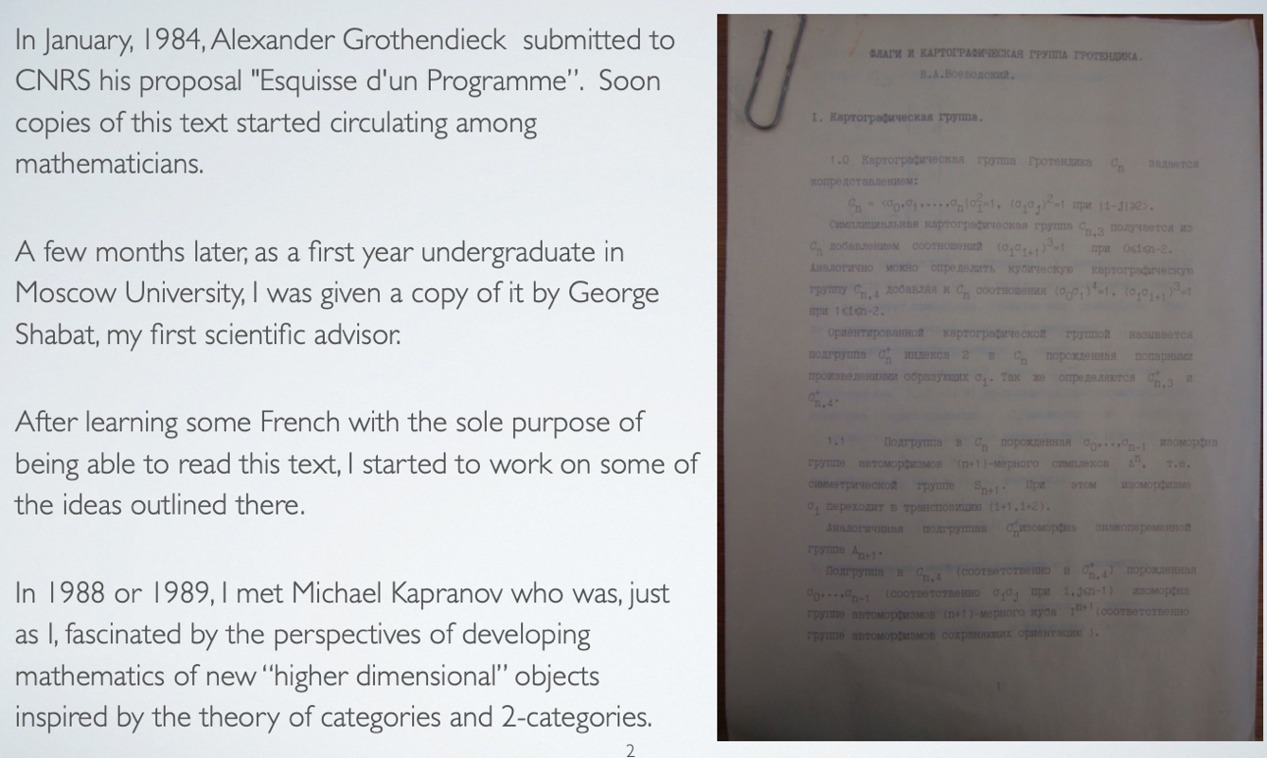
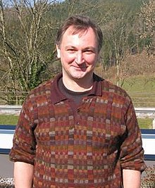
The Story behind Univalent Foundation and its roots in Category Theory
Voevodsky in 2011
Image Source: Wikipedia

Slide 29
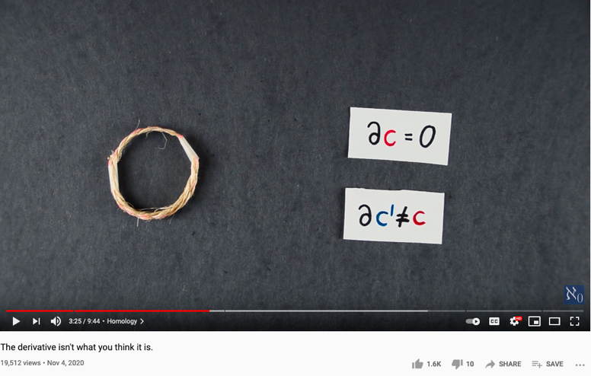
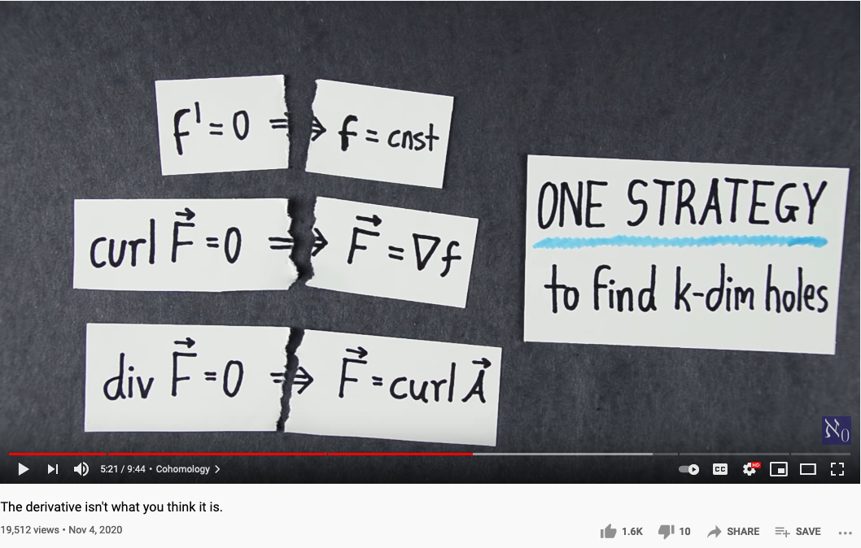
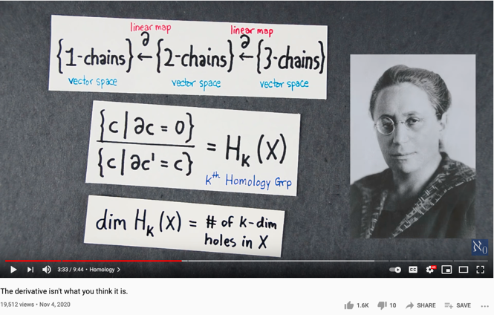
One Ring that rules them all (One Strategy to find all holes)
Source of Video : The Derivative isn’t what you think it is, by Aleph 0

Slide 30
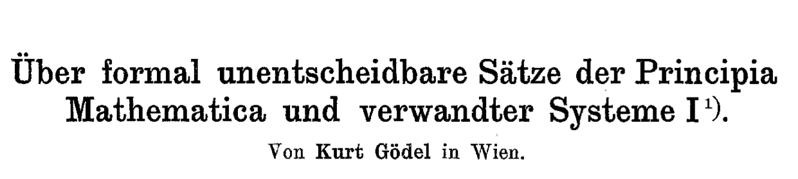
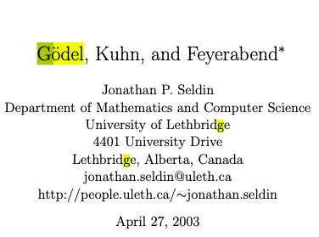
Automation can be applied to NsM
In mathematical logic, a Gödel numbering is a function that assigns to each symbol and well-formed formula of some formal language a unique natural number, called its Gödel number. The concept was used by Kurt Gödel for the proof of his incompleteness theorems. (Gödel 1931)
- Wikipedia on Gödel numbering
A question of Science and Commensurability
Paradigm shifting concepts
and
incommensurable terms
Thomas Kuhn [4] has presented a view of the history of science as a succession of “paradigms” which are not completely comparable with each other. Karl Popper [8] has attacked this view as being relativistic and denying that there is objective scientific truth. Popper seems to be saying that in order for science to be objectively true, every two scientific theories must be completely comparable. In taking this position, Popper is making a claim for a kind of completeness that is ruled out for theories strong enough to be “interesting” by Godel’s Incompleteness Theorem. In this paper, Godel’s Incomplete- ness Theorem and its proof will be used to draw conclusions about this conflict between Kuhn and Popper. In particular, it will be argued that if Popper had taken Godel’s Incompleteness Theorem into account, he would have wound up with a position consistent with that of Kuhn. Godel’s Incompleteness Theorem will also be used to argue that Feyerabend [3] does not really have an argument that there is no objective scientific method. The paper will close with some remarks on what might really count as objective scientific truth.
Normal Science
Model
Drift
Model Crisis
Model Revolution
Paradigm
Change

Slide 31
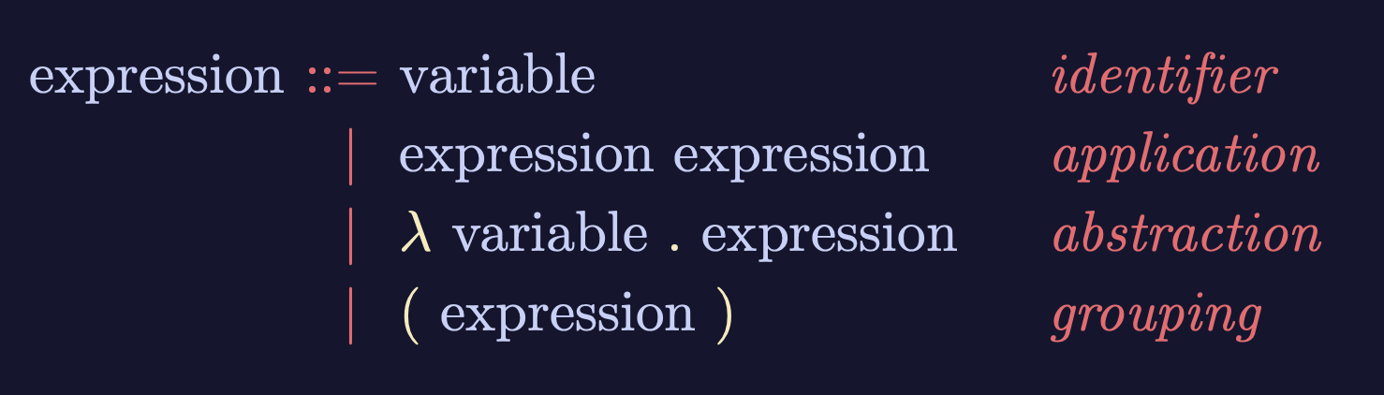
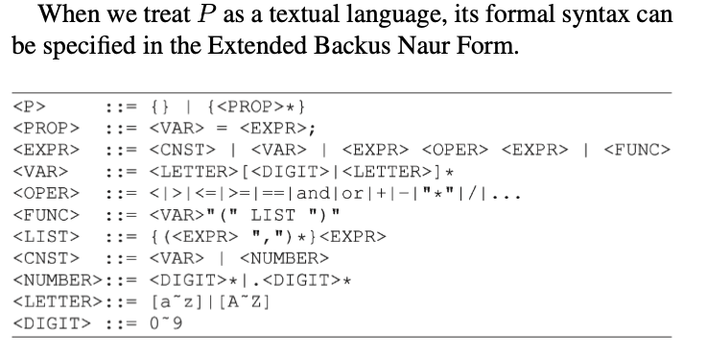

Lambda-Calculus is an Ouroboros
Variable
Expression1
Expression2
𝜆
Variable
Expression
( )
Expression
Lambda calculus as an executable rewrite process is a Lattice/Poset.
Paradigm shifting concepts
and
incommensurable terms
Normal Science
Model
Drift
Model Crisis
Model Revolution
Paradigm
Change
Learning as a vocabulary acquisition process!
Backus-Naur Form provides a way to customize the “concrete syntax” of formal languages.

Slide 32









A linguistic approach to unify the cognizance across scales
Namespace = Cognitive Space

Slide 33



Iteration and Recursion

Slide 34



Example I: multiplication
Run-time: proportional to n
Can be implemented in SW or HW
Division: similar idea.

Slide 35

The Fundamental Theorem of Arithmetic (Name Space Management Trick)
Huawei VP Mr. Yang Shaoqing
The fundamental theorem of arithmetic states that every positive integer (except the number 1) can be represented in exactly one way apart from rearrangement as a product of one or more primes (Hardy and Wright 1979, pp. 2-3).
- Excerpt for MathWorld website
https://youtu.be/8CluknrLeys?t=225
The fundamental theorem of arithmetic | Computer Science | Khan Academy

Slide 36

The Fundamental Theorem of Algebra
Huawei VP Mr. Yang Shaoqing
The fundamental theorem of algebra states that every non-constant single-variable polynomial with complex coefficients has at least one complex root. This includes polynomials with real coefficients, since every real number is a complex number with its imaginary part equal to zero.
https://youtu.be/shEk8sz1oOw?t=110
- Excerpt for Wikipedia
Fundamental Theorem of Algebra - Numberphile

Slide 37

The Fundamental Theorem of Calculus
The fundamental theorem of calculus is a theorem that links the concept of differentiating a function with the concept of integrating a function.
The first part of the theorem, sometimes called the first fundamental theorem of calculus, states that one of the antiderivatives (also called indefinite integral), say F, of some function f may be obtained as the integral of f with a variable bound of integration. This implies the existence of antiderivatives for continuous functions.^{[1]}
Conversely, the second part of the theorem, sometimes called the second fundamental theorem of calculus, states that the integral of a function f over some interval can be computed by using any one, say F, of its infinitely many antiderivatives. This part of the theorem has key practical applications, because explicitly finding the antiderivative of a function by symbolic integration avoids numerical integration to compute integrals. This provides generally a better numerical accuracy.
Huawei VP Mr. Yang Shaoqing
- Excerpt for Wikipedia
https://youtu.be/rfG8ce4nNh0?t=729
3BLUE1BROWN SERIES S2 • E8

Slide 38




The Fundamental Theorem of Calculus in N-dimensions

Slide 39


What is a Natural Transformation?
The two dashed paths shown above are homotopic relative to their endpoints. The animation represents one possible homotopy.
Image and Text Source: https://ncatlab.org/nlab/show/natural+transformation

Slide 40


What is a Functor?
Image and Text Source: https://ncatlab.org/nlab/show/functor

Slide 41



Functor as Structure Preserving Arrow
Youtuber blargoner: An introduction to categories, functors, and universal properties, with applications to the lambda calculus and functional programming.

Slide 42


What is a Morphism (Function)?
Image and Text Source: https://ncatlab.org/nlab/show/morphism
Image Source: P.15 of Path Integral and Hamiltonian by Belal Baaquie

Slide 43

Turing Machine in terms of Poly (Category Theoretical Terms)
Huawei VP Mr. Yang Shaoqing
Dr. David Spivak on Youtube Topos Channel

Slide 44



The Polynomial trick also appears in Fast Fourier Transform
Huawei VP Mr. Yang Shaoqing
https://youtu.be/h7apO7q16V0?t=732

Slide 45


When explaining the idea of Universal Properties …
We have explained certain aspects of all other properties in the ring.
Huawei VP Mr. Yang Shaoqing

Slide 46



Posets as Composable Namespaces
Image Source: Symmetric chain decompositions of partially ordered sets by Ondrej Zjevik
Image Source: The Number of Ordered Partially Ordered Sets by David Klarner

Slide 47



All computable content can be organized into a single Tapestry
Memory management in Jack Operating System

Slide 48

Universality is in your pocket (cellphone)
A lecture that students of Cognitive Foundation must watch several times…

Slide 49
The VM model and language
Perspective:
From here till the end of the next lecture we describe the VM model used in the Hack-Jack platform
Other VM models (like Java’s JVM/JRE and .NET’s IL/CLR) are similar in spirit but differ in scope and details.
Several different ways to think about the notion of a virtual machine:
Abstract software engineering view: the VM is an interesting abstraction that makes sense in its own right
Practical software engineering view: the VM code layer enables “managed code” (e.g. enhanced security)
Pragmatic compiler writing view: a VM architecture makes writing a compiler much easier (as we’ll see later in the course)
Opportunistic empire builder view: a VM architecture allows writing high-level code once and have it run on many target platforms with little or no modification.

Slide 50

Web Assembly (WASM VM)
Near Naitive Performance, Cross Platform (modern browsers), Lightweight

Slide 51


Before Stack-oriented computation, let’s re-examine Lambda Calculus
Notes:
51

Slide 52


The Magical Power of Recursion
Huawei VP Mr. Yang Shaoqing
Video last viewed: October 26, 2020.
Video last viewed: October 26, 2020.

Slide 53

Head Recursion
Huawei VP Mr. Yang Shaoqing
Video last viewed: October 26, 2020.

Slide 54

Tail Recursion
Huawei VP Mr. Yang Shaoqing
Video last viewed: October 26, 2020.

Slide 55

Comparing Head and Tail Recursion
Huawei VP Mr. Yang Shaoqing
Video last viewed: October 26, 2020.

Slide 56

A Typical Example of Recursion
Huawei VP Mr. Yang Shaoqing
Video last viewed: October 26, 2020.

Slide 57

Primitive Recursion’s Universal Power
Huawei VP Mr. Yang Shaoqing
Video last viewed: October 26, 2020.

Slide 58
The Consequence of applying Universal Properties
It assumes that solutions are in one place, the Universe of possibilities…
All concepts share the same root,
so that they are all comparable
and henceforth,
computable!

Slide 59
Types in Name Space Management
There are only five (5) KINDs of Lambda Expressions,
and they can be Computationally Complete…
Variable
a
Expression1
Expression2
b
𝜆
Variable
Expression
c
( )
Expression
d
e (empty type)

Slide 60





Bird Watcher and Combinatorics
I, K, B, C(W), S
Idiot
Blue Bird
Kestrel
Cardinal
Startling
The website of absint.com stated: “Safety standards like ISO 26262, DO-178B, DO-178C, IEC-61508, and EN-50128 require identifying functional and non-functional hazards and demonstrating that the soft­ware does not violate the rele­vant safety goals.”

Slide 61

The Five Combinators
I, K, B, W, S
I
K
B
W
S
- excepts from Internet Encyclopedia of Philosophy

Slide 62




The Members of a Bird Watching Club
advisor
to
Members of
the same bird watching club
George D. Birkhoff
father of
Haskell Brooks Curry
Norbert Wiener
During this period, Curry had become interested in logic. Originally, all of his logic was reading on the side, and at one point he was supposed to be working on a dissertation on a topic in differential equations assigned to him by George D. Birkhoff. Furthermore, he was getting advice from various faculty members at Harvard and elsewhere to stay away from logic. This advice was especially strong from Norbert Wiener, who was at MIT and who was a member of the same birdwatching club as Curry. But Curry had become too interested in logic to stop thinking about it.
- excepts from Internet Encyclopedia of Philosophy
Garrett Birkhoff
(Lattice Theory)

Slide 63

Be Persistent…
Tries to convince each other
Haskell Brooks Curry
Norbert Wiener
Curry had the idea for using operators which he called combinators, the term we still use today. He used these operators to analyze this rule of substitution, and he concluded that this idea might lead to a dissertation. When he took this idea to several professors, he got a different reaction than he had previously had about staying away from logic. This was especially true of Norbert Wiener at MIT, who said that his opinion had been that logic was a subject to be avoided “unless you had something to say,” and since Curry clearly had something to say, “strength to your right arm!”
- excepts from Internet Encyclopedia of Philosophy

Slide 64

An Inherited Idea: Function Currying
Acknowledged the source from
Haskell Brooks Curry
Moses Schönfinkel
The method of using only functions of one argument has come to be called currying, … Curry himself learned of this use of his name in his last years, and he protested because he had gotten the idea from Schönfinkel, but this use of Curry’s name has stuck.
- excepts from Internet Encyclopedia of Philosophy

Slide 65






The Allegory of the Master Algorithm
（寓言）
The Allegory of a Smart City made of 3 concentric circles and occupied by 5 tribes:
Circles:
Optimization (Search)
Evaluation (Assessment and Rewrite)
Representation (NsM)
Practical Concerns:
Optimization (Search)
Scalability
Evaluation (Assessment and Rewrite)
Correctness
Representation (NsM)
Sound/Complete
Master
Equation
Chinese Translation
Image Source: P. 240 of The Master Algorithm
65

Slide 66




“The” Book of Why

Slide 67
Why is the question “Why” important?
“Why” is a special type of “What”!
“What” is “how”?
“How” is a type of “executable program”!
“Executable programs” are composed of “Whats”!
Universal Computation is about always computing in “types” of whats!

Slide 68




A few screen shot for basic data types?
Variable
Expression1
Expression2
𝜆
Variable
Expression
( )
Expression
Two types of Products
Outer Product and Inner Product
or
Product/Co-Product

Slide 69

How about NN/AI/Machine Learning?
Variable
Expression1
Expression2
𝜆
Variable
Expression
( )
Expression

Slide 70
Adequate NsM is Challenging
Over his career, Curry changed several times the words he used to denote the formal objects of a formal system. In his earliest work on combinatory logic, he called them “entities” (using the German word Etwas as a noun in his dissertation, which was written in German). However, in a discussion with a philosopher (whom he did not name in his later years), he was told that his use of that word implied some philosophical conclusions with which he disagreed. At that point, he decided to use the word “term” instead. It is now common to refer to “combinatory terms” and “𝝺-terms”. However, this caused him a problem when he was dealing with a formal system of logic with quantifiers, since the terms would be what are usually called “formulas”, and there are other formal objects called “terms”. So in the end, he coined his own word by taking the first syllable of the word “object”, and started calling them obs. To some people, the word ob appeared to refer specifically to combinatory logic, but in fact Curry used the word for formal objects of any kind of formal system.
- excepts from Internet Encyclopedia of Philosophy

Slide 71
Abstraction
Separate Specification from Abstraction
Concretization
The principles of choosing name
Gödel Numbering
Church’s Encoding
Diagonalization argument
The actual set of chosen names
Natural Numbers as names
Lambda (Functional) Abstraction
Determining name’s countability
A well-defined set of Actions and iterative Branching Strategies
A Roadmap of composable activities
Sequencing and timing conditions
Explicitly state dependencies and resource requirements

Slide 72
The aim is to derive a finite and “reasonably small” symbol set
Reduced Instruction Set Computer (RISC) | Complex Instruction Set Computer (CISC)
Smaller number of hardwired ”instructions” | Larger number of hardwired “instructions”
Machine Oriented | Programmer Oriented
Requires single clock cycle to execute an instruction | Requires multiple clock cycle to execute an instruction
More registers | Fewer Registers
Simple format with simple addressing modes | Complex format with complex addressing modes
Requires more amount of RAM | Requires a minimum amount of RAM
Used in Mobile Phones and Tablets | Used in Laptop/Desktop/Servers
Excerpts from: PROCESSOR KNOWLEDGE: ANALYSIS AND COMPARISON OF RISC AND CISC ARCHITECTURE

Slide 73




Timing is important, and it gives order properties

Slide 74







All System can be approximated as Partially Ordered Set
Numbers are naturally related to Music:

Slide 75



All meaningful expressions can be modeled as $𝒫ω$
Prof. Dana Stewart Scott
Image Source: Britannica

Slide 76



Lattice represents a Universal Data Type
Patrick Cousot
Radhia Cousot
Source of Text : https://www.di.ens.fr/~cousot/publications.www/CousotCousot-POPL-77-ACM-p238--252-1977.pdf

Slide 77

Poset(Lattice) is universal, how about Tensor?
Lattice is a partially ordered set that can be used to describe all computable functions…
Tensor is a mathematical object, and a data format that is conveniently implelemented with computer hardware to perform large-scale computation, while rest on the foundation of linear algebra and other mathematical principles.
You need some background in Abstract Algebra to watch this video…

Slide 78














An integrated (ethical) architecture
to implement the Master Algorithm
Software
Hardware
Scientific “Evolution”
Neutral Network
Symbolic Logic
Causal Probability
Conceptual Analogies
T. Kuhn
Content
IoT and Quantum Computing
TPU
GPU
CPU
Big Data
Computed Data
Artificial Data
Resource
Standard
J. Hinton
Distributed
Centralized
Poset/Lattice
General Protocol
Curry Haskell
Governance Strategies
Tensor
Collective learning systems
J. Pearl
Data Assets, Structures
Extreme Learning Process
G. Lakoff
Computing Architectures, Instrumentation
Encoding strategy, Ontology, Epistemology

Slide 79


Tensor as the Generalized Data Type
Please subscribe to this channel …

Slide 80

Memory management (naive)
When a program constructs (destructs) an object, the OS has to allocate (de-allocate) a RAM block on the heap:
alloc(size): returns a reference to a free RAM block of size size
deAlloc(object): recycles the RAM block that object refers to
The data structure that this algorithm manages is a single pointer: free.

Slide 81

Memory management (improved)

Slide 82
Memory-mapped screen

Slide 83
All computable content can be organized into a single Tapestry
Memory management in Jack Operating System

Slide 84

How to draw a line?
drawLine(x1,y1,x2,y2)
Basic idea: drawLine is implemented through a sequence of drawPixel operations
Challenge 1: which pixels should be drawn ?
Challenge 2: how to draw the line fast ?
Simplifying assumption: the line that we are asked to draw goes north-east.
Notes:
84

Slide 85


Line Drawing algorithm
drawLine(x,y,x+dx,y+dy)
set (a,b) = (0,0)
while (a ≤ dx) and (b ≤ dy)
drawPixel(x+a,y+b)
decide if you want to go right, or up
if you decide to go right, set a=a+1; if you decide to go up, set b=b+1
drawLine(x,y,x+dx,y+dy)
set (a,b) = (0,0)
while (a ≤ dx) and (b ≤ dy)
drawPixel(x+a,y+b)
if b/a > dy/dx set a=a+1 else set b=b+1
Oy Vey
Notes:
85

Slide 86
Line Drawing algorithm, optimized
Motivation
When you draw polygons, e.g. in animation or video, you need to draw millions of lines
Therefore, drawLine must be ultra fast
Division is a very slow operation
Addition is ultra fast (hardware based)
drawLine(x,y,x+dx,y+dy)
set (a,b) = (0,0)
while (a ≤ dx) and (b ≤ dy)
drawPixel(x+a,y+b)
if b/a > dy/dx set a=a+1 else set b=b+1
b/a > dy/dx is the same as a*dy < b*dx
Define diff = a*dy – b*dx
Let’s take a close look at this diff:
b/a > dy/dx is the same as diff < 0
When we set (a,b)=(0,0), diff = 0
When we set a=a+1, diff goes up by dy
When we set b=b+1, diff goes down by dx
drawLine(x,y,x+dx,y+dy)
set (a,b) = (0,0), diff = 0
while (a ≤ dx) and (b ≤ dy)
drawPixel(x+a,y+b)
if diff < 0 set a=a+1, diff = diff + dx else set b=b+1, diff = diff - dy
Notes:
86

Slide 87
The inequality (ordering) operator makes all the ”computation”
Common relational operators
Convention | equal to | not equal to | greater than | less than | greater than or equal to | less than or equal to
In print | = | ≠ | > | < | ≥ | ≤
FORTRAN^{[note 1]} | .EQ. | .NE. | .GT. | .LT. | .GE. | .LE.
ALGOL 68^{[note 2]} | = | ≠ | > | < | ≥ | ≤
 |  | /= |  |  | >= | <=
 | eq | ne | gt | lt | ge | le
APL | = | ≠ | > | < | ≥ | ≤
BASIC, ML, Pascal^{[note 3]} | = | <> | > | < | >= | <=
MUMPS | = | '= | > | < | '< | '>
Lua | == | ~= | > | < | >= | <=
C-like^{[note 4]} | == | != | > | < | >= | <=
Erlang | == | /= | > | < | >= | =<
 | =:= | =/=
Bourne-like shells^{[note 5]} | -eq | -ne | -gt | -lt | -ge | -le
Batch file | EQU | NEQ | GTR | LSS | GEQ | LEQ
MATLAB^{[note 6]} | == | ~= | > | < | >= | <=
 | eq(x,y) | ne(x,y) | gt(x,y) | lt(x,y) | ge(x,y) | le(x,y)
Fortran 90^{[note 7]}, Haskell | == | /= | > | < | >= | <=
Mathematica^{[3]} | == | != | > | < | >= | <=
 | Equal[x,y] | Unequal[x,y] | Greater[x,y] | Less[x,y] | GreaterEqual[x,y] | LessEqual[x,y]
Excerpts from Wikipedia: Relational Operators in Programming Languages

Slide 88
Universality is in your pocket (cellphone)
A lecture that students of Cognitive Foundation must watch several times…

Slide 89
A curriculum based on Data-assimilation Orientation

Slide 90
If Universality is known, then, what?
Time is progressing, so will entropy increase (Know your spatial-temporal context):
The future still has lots to be known…
Fitting decision models to ever wider ranges of application contexts:
Why: The interactive complexity of (known) computing systems will continue to surprise us.
How: Decision (System Design) tools are not yet mature/intuitive enough to cover all areas of applications
What: The vehicles (computing devices) that perform the computation are still being miniaturized and expanded in capabilities.

Slide 91



Performance Measurements
Turing award winners, and authors of
Computer Architecture: a quantitative approach
Founder of
RISC-V
Instruction Set
Former president of
Stanford U.
Image source: UC Berkeley David Patterson
Image source: Wikipedia John Hennesey

Slide 92


The to-be Modernized Digital Workflow
You may download all these tools here.

Slide 93

Toyhouse Mediawiki
Please get an account on ToyhouseWiki：http://toyhouse.wiki:81

Slide 94


Universality in Textbook

Slide 95


Tools and Books are freely available for building complex systems
http://chimera.labs.oreilly.com/books/1234000000754/index.html

Slide 96

How to measure with generality?
An important foundation in quantitative measurements!

Slide 97

What distinguishes Thinking and Design?
Martin H. Fischer
(10 Nov 1879 - 19 Jan 1962)
“Knowledge is a process of piling up facts; wisdom lies in their simplification.”
~ Martin H. Fischer
Encore : A Continuing Anthology
(March 1945), "Fischerisms" p. 309

Slide 98




Cybernetics as Applied Category Theory
In Ross Ashby’s work, he presented Cybernetics as an abstract framework for representing a variety of formal rewrite systems.
Later Norbert Wiener also stated that Monad plays an important role in this Cybernetic. Which suggest that it needs a Universal Rewrite mechanism, like Lambda-Calculus, which is realized in Backus-Naur Form.
Image source: Design for a Brain by Ashby
Paradigm shifting concepts
and
incommensurable terms
Normal Science
Model
Drift
Model Crisis
Model Revolution
Paradigm
Change
Learning as a vocabulary acquisition process!
Early alchemical ouroboros illustration with the words ἓν τὸ πᾶν ("The All is One") from the work of Cleopatra the Alchemist in MS Marciana gr. Z. 299. (10th Century)
Image and Text: Wikipedia
Backus-Naur Form provides a way to customize the “concrete syntax” of formal languages.

Slide 99
Conclusion: What have we learned?
Computational Thinking is rooted in Logic (re-write/substitution system):
Namespace management (NsM) and function composition can be scaled up by computers
The hierarchy of namespaces (the six layers of languages) helps disseminate computational thinking in a Systematic Fashion (System Design)
Computational Thinking and Systems Design is domain independent:
Why: Universality can be expressed in compact and finite forms, so that it can be embedded in a portable device, mentally and physically.
How: Multi-layered System Design Languages enables engineering practice, inter-layer translation explains the design choices and performance tradeoffs
What: The vocabulary and syntax of each layer helps you focus your mind and efforts

